Slide 1
Meta stock price information Analysis
Aiden Lin

Slide 2
Dataset Used:
Meta Stock
https://datasetsearch.research.google.com/search?src=0&query=meta%20stock&docid=L2cvMTFzODNzbnFqZA%3D%3D

Slide 3
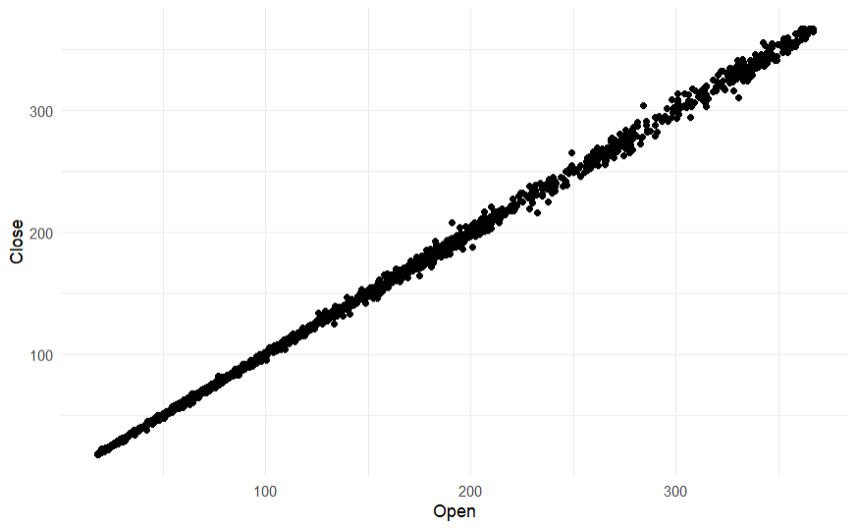

Slide 4
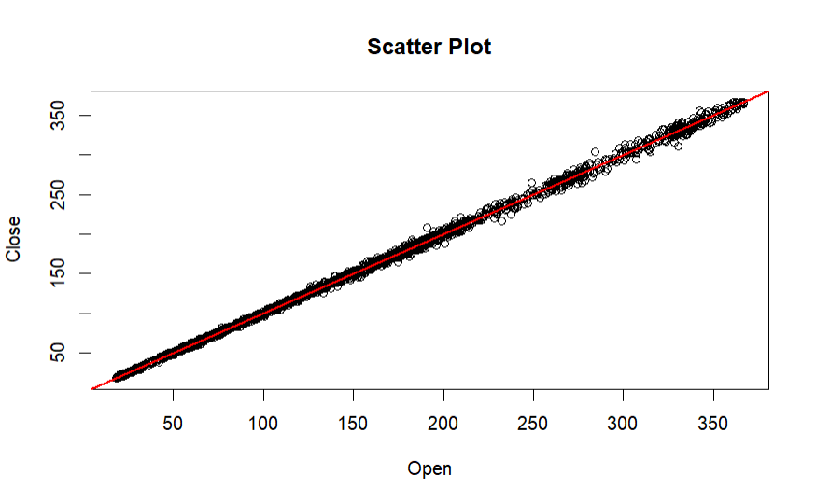

Slide 5
Methodology
Quantitative data analysis
Numerical data (prices)

Slide 6
Key Findings:
Open and close prices on Meta stock have a strong positive correlation

Slide 7
Conclusion
Based on the information gathered from my data analysis, the open and close prices of this particular stock are nearly 1:1.
The model can be used to predict the close prices of a Meta stock given the opening price, which may be useful to stock buyers and investors.

